Slide 1

Summer Student Showcase Info Session
7/18/2022
Jessica Goodard
ASPIRE STEM Program Specialist
201 STEM Center
x83339
We will get started at 1:05pm. In the meantime, put your answers in the chat!

Slide 2
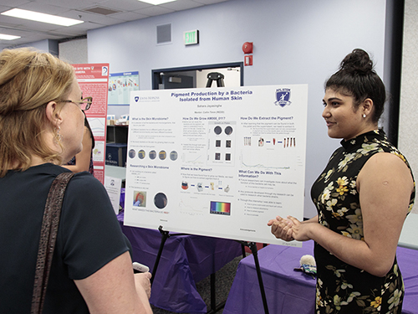
What is the Student Showcase?
The ASPIRE Student Showcase is ASPIRE’s public-facing capstone event for nominated students
Students must be nominated to participate. Not every student will be selected to participate.
The event is open to all APL staff and interns, as well as members of the public, including your families, friends, teachers, and other members of the community

Slide 3
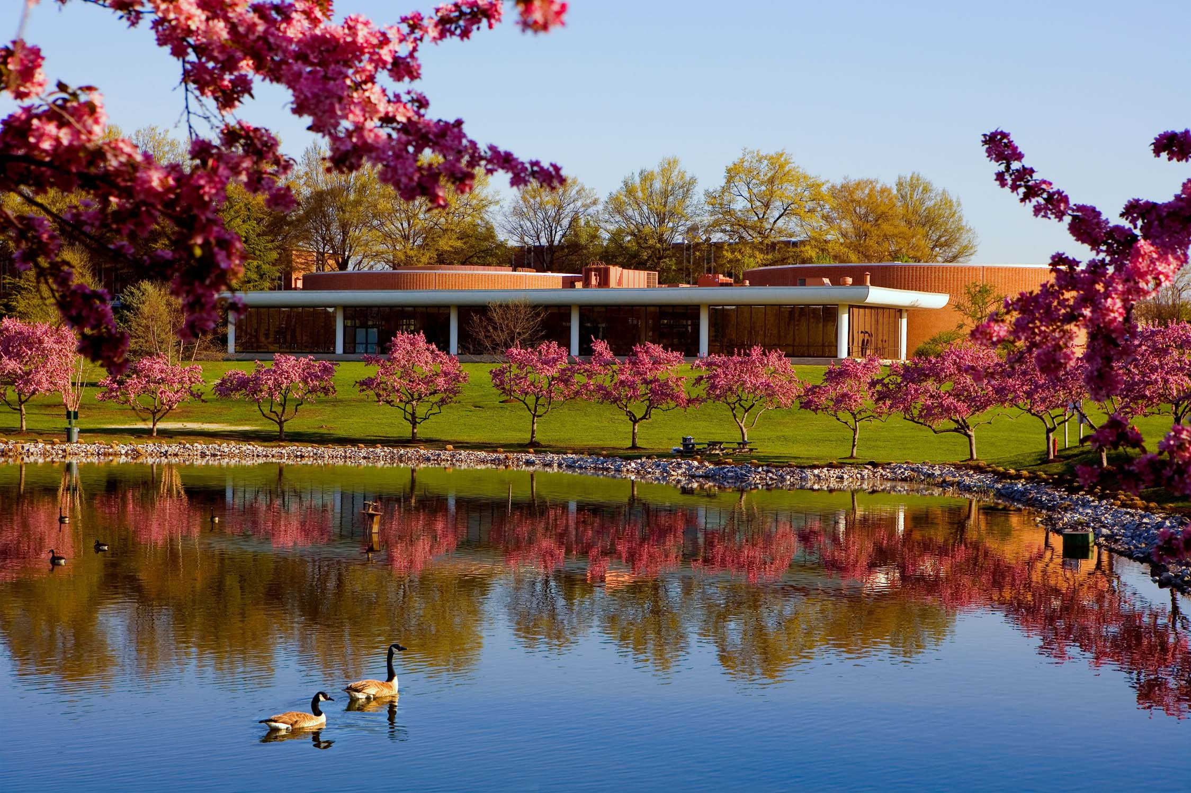
What is the Student Showcase?
This year, the Showcase will be live in the Kossiakoff Center (Kossi or K-Center) on August 18th from 5pm-7pm. We will have refreshments.
Students will accompany their physical posters and present to the audience as they float through the auditorium. You may bring additional props, demos, etc. Just let me know.
Students may present individually or in small groups.
Students will also be invited to display their work online in a digital gallery. See the link in the chat for last year’s digital gallery example.
Due to space constraints, not every student who is nominated will be selected to present in-person. However, all students will have an opportunity to be featured online. We cannot post videos or slides. Just one poster.
The ASPIRE Showcase is free and open to the public. All visitors will be expected to abide by APL’s visitor policies.

Slide 4
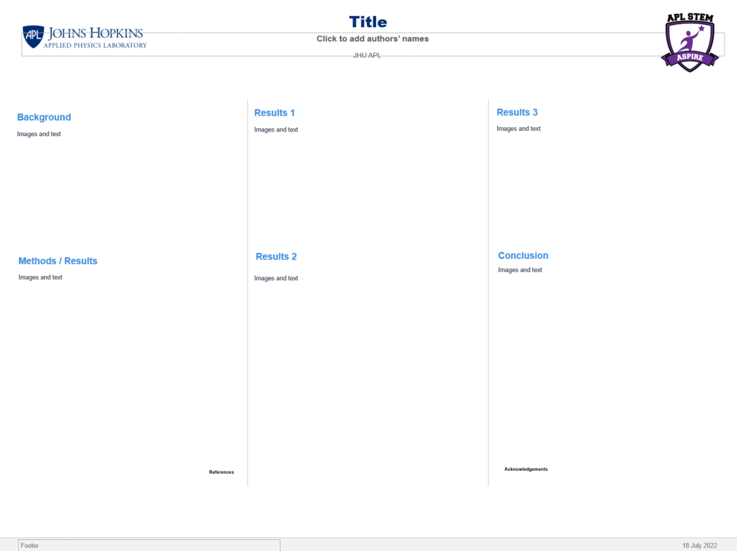
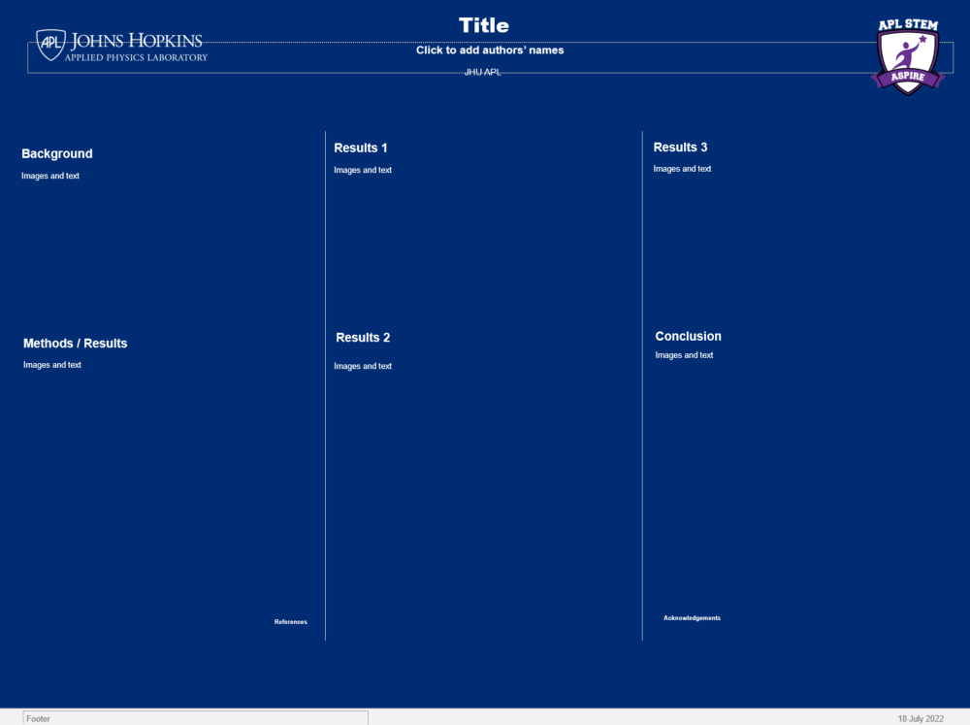
Poster Template
Every ASPIRE student is required to complete a poster at the end of the term.
Student posters are created via PowerPoint. Students selected for the Showcase have their posters printed on heavy-duty foam board by the STEM Office.
Students will be provided with a poster template. The Showcase poster template and the ASPIRE poster template are the same.
Your Showcase poster counts as your end of term poster.
You may deviate from the template as long as you do not deviate from the size or aspect ratio of the slide. Note: These are not wide screen templates. This is to better accommodate the printing process.

Slide 5
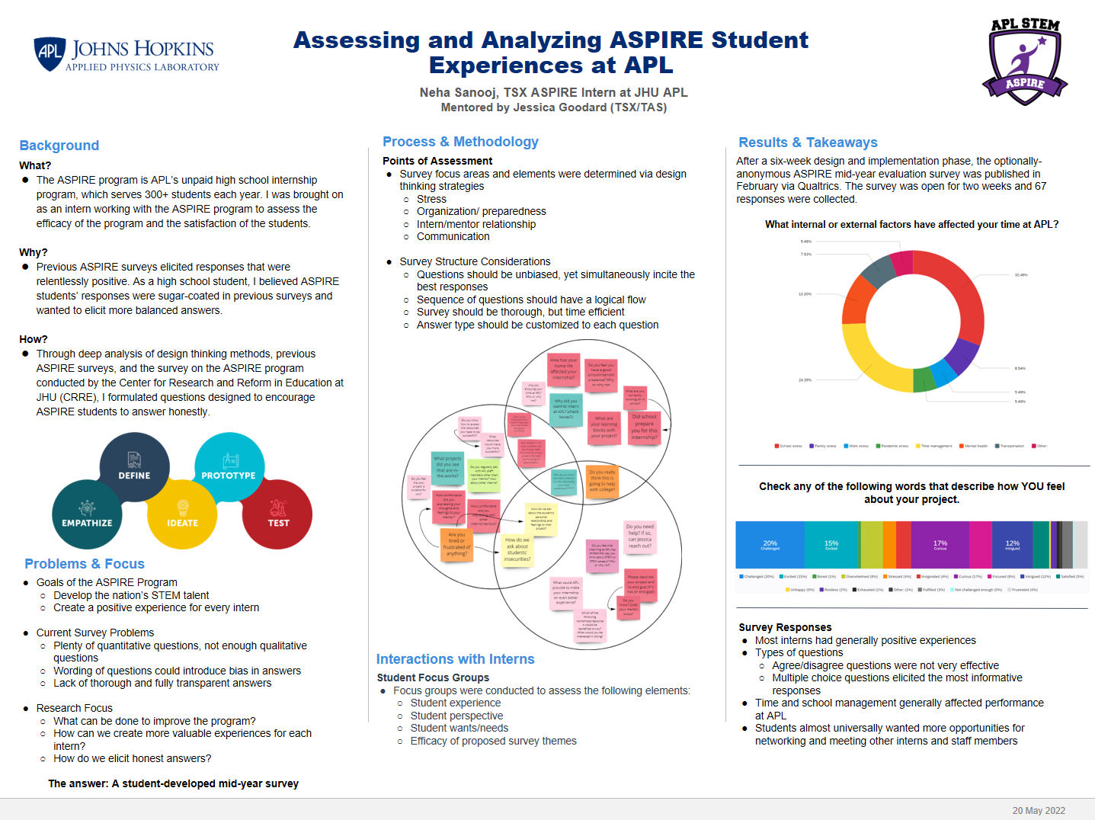

Slide 6
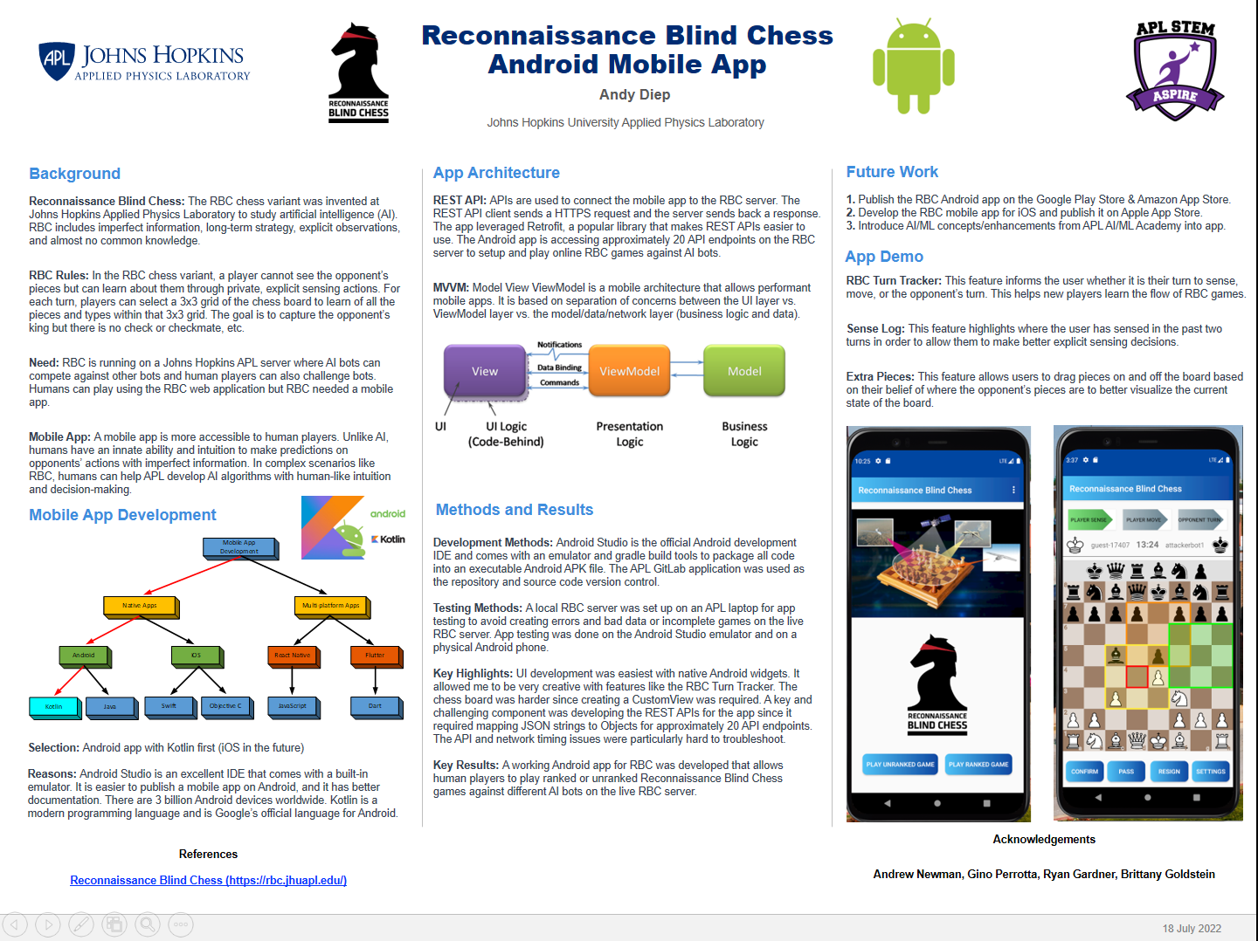

Slide 7
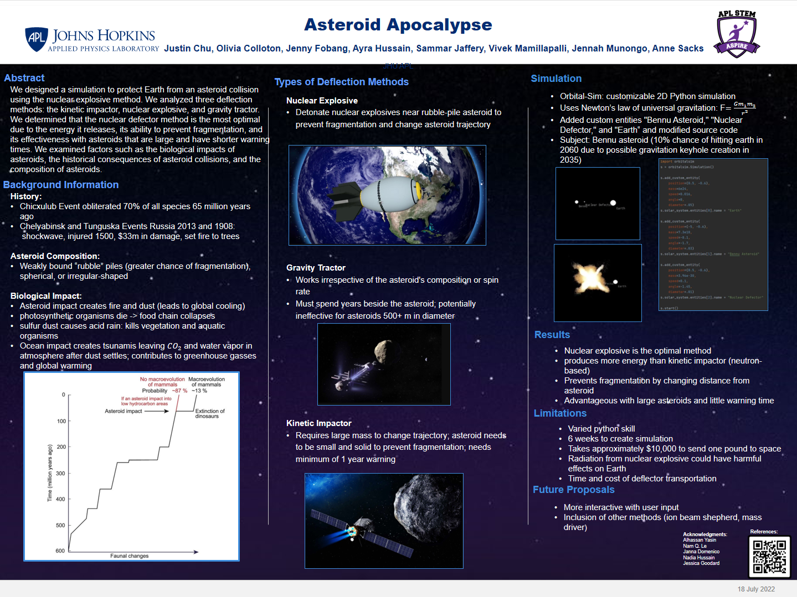

Slide 8
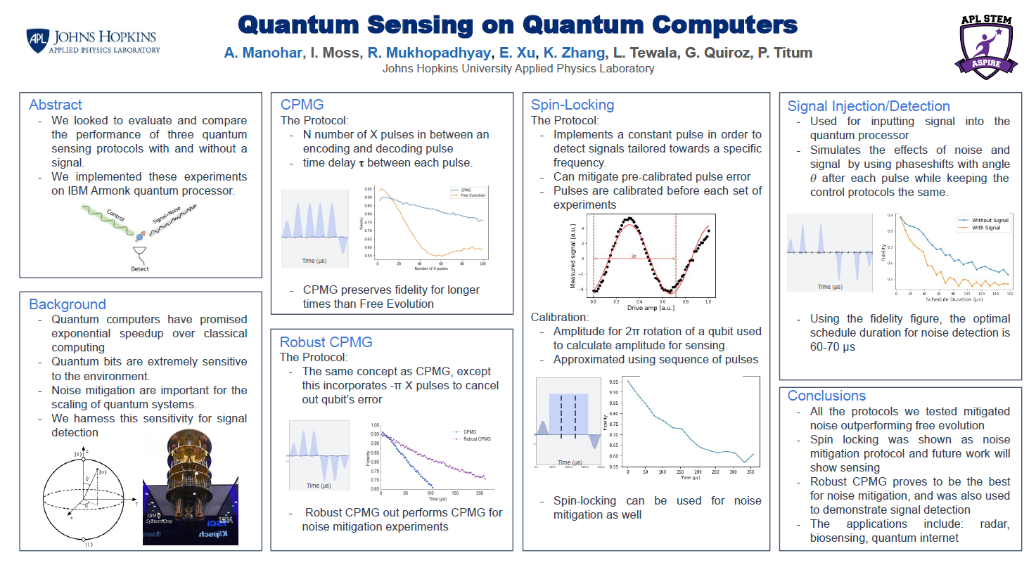

Slide 9
Participation Considerations
Students
Would you like to share what you’ve worked on at APL?
Would you like experience in a conference setting?
Would you like to gain experience speaking to an audience?
Can you prepare a poster in the next thee weeks?
Mentors
Do you have the bandwidth to help guide your student through this capstone? They will need help preparing their poster and talk.
Can you help your student craft a narrative (beginning, middle, and end) of their project?
Can you help your student get their project through the RRT?

Slide 10
Review and Release Tool
Whether or not a project needs to go through the Review and Release Tool (RRT) is at the mentor’s discretion. They are ultimately responsible for what is released to the public.
Needs RRT | Likely does not need RRT
Student project contains any sponsor-related, APL proprietary, or CUI information or data | Student project contains only general/non-APL specific information and data
Student project is part of an APL initiative, such as an IRAD | Student project is an independent study and/or adjacent to APL work (i.e., creating an algorithm that has nothing to do with the mentor’s project, etc.)
Student project resulted in a deliverable that will be used in future APL work | Student project primarily serves the student’s needs and does not have any immediate APL integration
Type RRT/ into your browser
Mentors must submit on their students’ behalf and must choose the proper reviewers
Give the reviewers a head’s up, and usually projects are cleared in less than a week
Sponsor work may take longer to clear

Slide 11
Deadlines
Nominations
Mentors must nominate students in order for students to be considered
Nominations are due by COB 7/22
The project title and description you list will be used in the digital gallery!
In-person presenter and featured members of the digital gallery will be announced 7/27
RRT
It is recommended that posters that need to go through RRT are submitted by 8/4
Mentors are responsible for determining if a project needs to go through RRT
Student submissions
Students are required to submit the following to the Box folder by COB 8/12:
A thumbnail picture of themselves or their group
Their finalized poster
Everything goes over to the printers at 8:00am Monday 8/15. I will not be able to accept late posters.

